Slide 1
CST 2355 – Database Systems
Week 3

Slide 2
Topics Covered:
Microsoft Access – Reports
Microsoft Access – Queries (esp. Updates Queries)
Microsoft Access – Triggers
ODBC and connectivity

Slide 3
Microsoft Access – Reports (continued)
Display of information – could look like a “form” with text boxes, etc
Can have parameterized reports using “filter” parameters to provide specific values for parameters to be used in the data source for a report
Often a combo-box (i.e., value selected from a list generated from a query) is provided to the user to select a value
Can use Visual Basic for Applications (VBA) to build OnClick events, etc.
Demo of Report Selection Dialog (Northwind Sales reports example)
Use of Domain functions for lookups, counts, …

Slide 4
Microsoft Access –Queries …
Query Types:
Select: query selects data from tables and nested queries (for use)
Similar to “CREATE VIEW viewname AS query;”
Can access the query as a virtual table
Make Table: query selects data from the other tables and queries and saves the resulting data as a new table
Creates a snapshot of the data
Similar to “CREATE MATERIALIZED VIEW mvname AS query;”
Append: query selects data from tables and queries and inserts the resulting data as new records in a particular table
Inserts a snapshot of the data
Similar to “INSERT INTO mytable ( fieldlist ) query;”
Note: query must have fields as given in the fieldlist
Update: updates selected records in a particular table based on given criteria to new value(s)
Delete: deletes selected records in a particular table based on given criteria
Crosstab: creates a result set aggregated by two “dimension” sets of values; one down the left side of the datasheet and the other across the top
Often used in generating data for display in financial reports; e.g., sum of number of sales with two dimensions as (product, location)

Slide 5
Microsoft Access – … Queries
Best Practice:
First Step
Create a “SELECT” query (add tables, queries and choose the required fields)
Test the query by running it to make sure it selects the appropriate rows and fields
THEN:
Modify the type of the query to the type required (e.g., append, update, delete)
Save the query
Run the query

Slide 6
Microsoft Access – Triggers
In Access the event handlers are associated with a FORM (not the individual tables…)!
Events occur for records on forms when you move the focus to a different record, update data in a record, delete an existing record or records, or create a new record.
Best Practice:
Create a form that allows updates to the table
Create event handlers associated with the form
Order of Events for Database Objects
See Microsoft documentation at:
Https://support.microsoft.com/en-us/office/order-of-events-for-database-objects-e76fbbfe-6180-4a52-8787-ce86553682f9
Or for just the form events:
https://support.microsoft.com/en-us/office/order-of-events-for-database-objects-e76fbbfe-6180-4a52-8787-ce86553682f9#bm2
Demo of Form events

Slide 7
Microsoft Access – ODBC and Connectivity …
ODBC – according to Microsoft:
As at:
https://docs.microsoft.com/en-us/sql/odbc/microsoft-open-database-connectivity-odbc?view=sql-server-ver15#:~:text=The%20Microsoft%20Open%20Database%20Connectivity,specifically%20for%20relational%20data%20stores.
The Microsoft Open Database Connectivity (ODBC) interface is a C programming language interface that makes it possible for applications to access data from a variety of database management systems (DBMSs). ODBC is a low-level, high-performance interface that is designed specifically for relational data stores.
The ODBC interface allows maximum interoperability-an application can access data in diverse DBMSs through a single interface. Moreover, that application will be independent of any DBMS from which it accesses data. Users of the application can add software components called drivers, which interface between an application and a specific DBMS.
MS-Access can use the ODBC drivers that are installed on your Windows environment, to connect to external data
ODBC provides full access to the dbms – to run ANY sql statement…. Including data control statements
Demo of Connection to External Data using ODBC, …

Slide 8
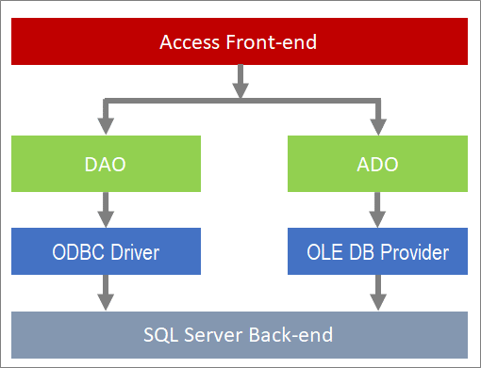
… Microsoft Access – ODBC and Connectivity
Connecting Access to a Back-end server using ODBC is described at:
https://support.microsoft.com/en-us/office/connect-access-to-sql-server-050d88f3-b2d6-4e76-b6f9-f3c556f139ea

Slide 9
ODBC Drivers in Access/Windows
Install the ODBC driver for the back-end database
Create a “DSN” for the particular database instance
Data Source Name
Use the Windows-level DSN when linking or downloading items from the external data source from Access
Demo of ODBC connections,…

